Slide 1


SEASONAL TRENDS OF EV SALES IN GOA
Presented by Swapnajit Mohapatra

Slide 2
INTRODUCTION
Today, we’ll explore the dynamic monthly patterns in electric vehicle sales in Goa. Understanding these seasonal shifts is crucial for optimizing sales, inventory, and marketing strategies in this unique market shaped by tourism, festivals, and local demand. By the end of this presentation, you’ll gain clear insights into when and why EV sales peak or dip throughout the year, helping us align business efforts with market rhythms for greater success.

Slide 3
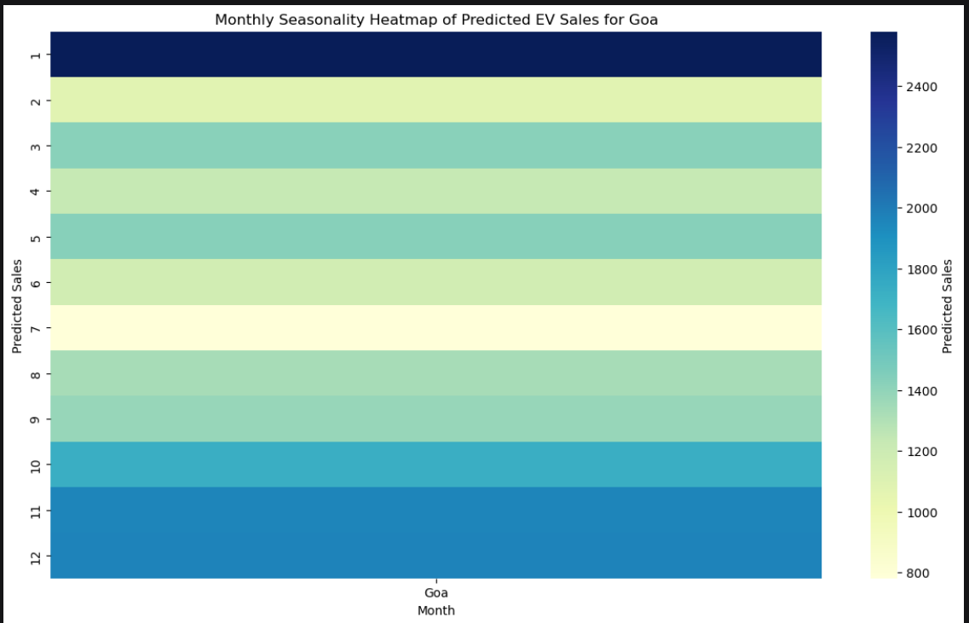
MONTHLY EV SALES IN GOA

Slide 4
JULY - LOWEST SALES (800 UNITS)
Reason for Dip: Post-holiday season; tourist off-season after peak festivities.
Reduced consumer spending and vehicle purchases after year-end.
End of government incentives impacting early year registrations.

Slide 5
NOVEMBER AND DECEMBER - HIGH SALES PEAK (2,300 AND 2,250 UNITS)
Reason for Peak: Start of winter tourist season; increased visitor influx.
Increased demand for personal electric two-wheelers due to local commuting needs.
Likely fleet purchases for shared 3W e-rickshaws and tour operators.
Possible subsidy or price incentive timing boosting mid-year sales.

Slide 6
AUGUST TO OCTOBER - STEADY SALES (1,800 TO 2,000 UNITS)
Post monsoon demand stabilization.
Build-up to festive season in October and November attracting buyers.
Early festive season offers and marketing campaigns drive sales.

Slide 7
JANUARY - HIGHEST SALES PEAK (2,600 UNITS)
Reason for Peak: Holiday and festival season; maximum tourist influx.
Peak buying season before/during year-end with higher disposable incomes.
Aggressive sales promotions and inventory stocking by dealers.
Government or local incentives timed for year-end.

Slide 8
RECOMMENDED EV MODELS TO PROMOTE
Electric Two-Wheelers (Scooters and Bikes):
Popular among local commuters and tourists for last-mile connectivity.
Promote affordable models with good battery range, suitable for Goa’s terrain.
Electric Three-Wheelers (Shared Mobility e-Rickshaws):
High demand during tourist seasons for short-distance rides.
Support electric fleet operators with attractive financing and service packages.
Electric Four-Wheelers (Small Personal and Fleet Cars):
Target mid to high-end buyers interested in eco-friendly personal transport.
Collaborate with taxi fleets and resorts offering electric vehicle services.

Slide 9
STRATEGIES TO BOOST EV SALES IN GOA
Marketing & Sales Solutions
Time Promotions Around Peak Months: November, December, and January for festive and tourist-driven campaigns.
Offer Seasonal Discounts and Financing: Align offers with festival seasons and tourist arrivals to boost urgency.
Targeted Digital Marketing: Use location-based ads focusing on tourists, local residents, and fleet operators.
Dealer & Fleet Incentives: Reward high-volume dealers and service providers who push EV adoption.
Inventory & Supply Planning
Stock Up Heavily Before Peak Seasons: Ensure showroom readiness and sufficient inventory before August and December.
Flexible Supply Chains: Adjust inventory based on monthly demand forecasting to avoid excess stock in off-peak months.
Service Network Expansion: Increase charging stations and after-sales support in tourist hotspots and urban centers.

Slide 10
SUMMARY
Tourist seasonality has the strongest impact ( November To January peaks).
Festival periods (December, January) encourage higher purchasing.
Off-season months (July) face dips due to lower tourist activity and spending.
Subsidy/incentive timing impacts monthly demand fluctuations.
Vehicle type assumption: peaks driven by personal 2W and shared 3W electric vehicles aligned with tourism and local transport needs.

Slide 11
Thank You

